Slide 1
Calculator Skills: Odd One Out for fx-83GT CW+, fx-85GT CW+ and fx-991 CW+ UK
Joely Fashokun

Slide 2
Teacher Guidance for Odd-One-Out
Using this resource:
This resource aims to improve calculator fluency by highlighting misconceptions about calculator entry. This resource can be used for all secondary pupils, however, it may be most appropriate for KS3 classes. The resource can be projected on the board, or printable versions are available.
Printable documents have been resized so that two worksheets (1 per student) are printed on each page.
Calculator Guidance:
Question L requires students to use the % button in the catalogue.
Find this by pressing CATALOG T > Probability 2 > % 1
Going Deeper:
These questions extend students’ calculator skills by probing them to think about how the use of the answer button, brackets or other changes to the input may affect the correct answer. Students should draw on ideas about negative numbers and BIDMAS, and how inputs are interpreted by calculators.

Slide 3
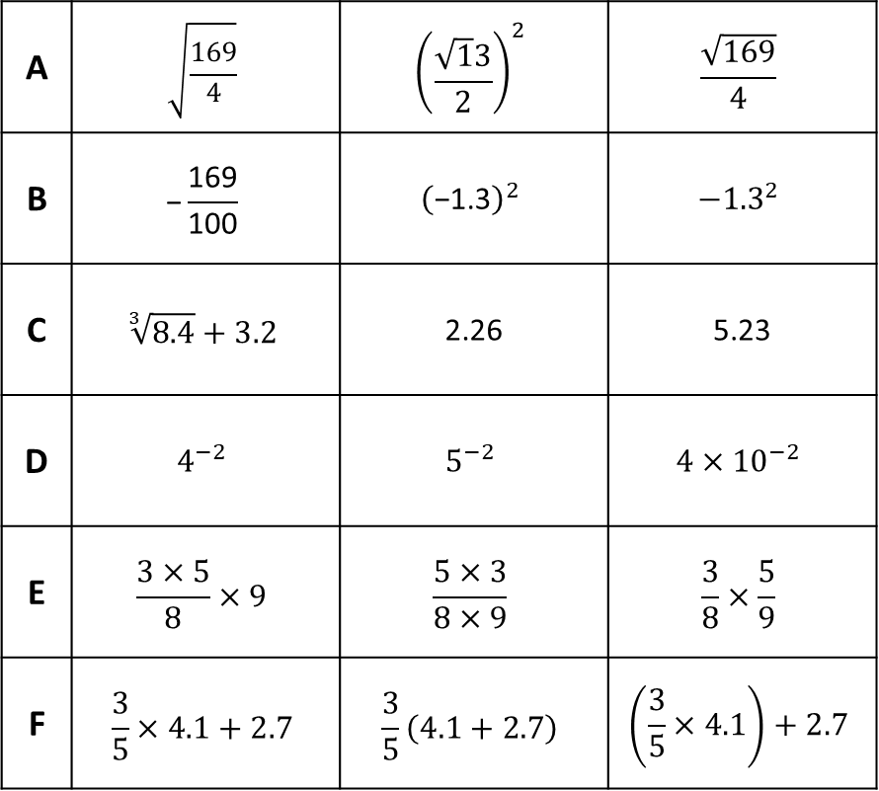
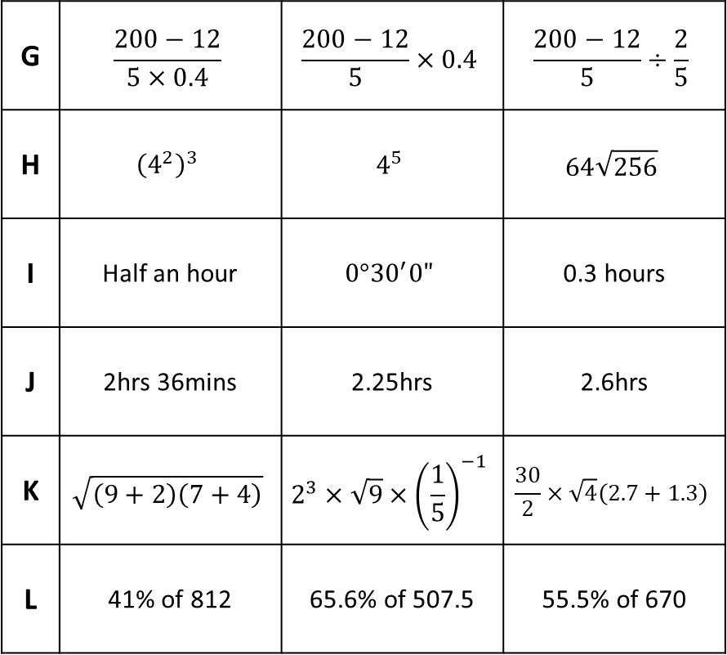
Calculator Skills: Odd-One-Out
Use your calculator to find the odd-one-out in each row. Give a reason for your answer.
A | $$\sqrt{\frac{\text{169}}{\text{4}}}$$ | $${\left(\frac{\sqrt{\text{1}}\text{3}}{\text{2}}\right)}^{2}$$ | $$\frac{\sqrt{\text{169}}}{\text{4}}$$
B | $$\text{−}\frac{\text{169}}{\text{100}}$$ | $${\left(\text{−1.3}\right)}^{2}$$ | $$−{1.3}^{2}$$
C | $$\sqrt[3]{8.4}+3.2$$ | 2.26 | 5.23
D | $$4^{−2}$$ | $$5^{−2}$$ | $$4×{10}^{−2}$$
E | $$\frac{3×5}{8}×9$$ | $$\frac{5×3}{8×9}$$ | $$\frac{3}{8}×\frac{5}{9}$$
F | $$\frac{3}{5}×4.1+2.7$$ | $$\frac{3}{5}\left(4.1+2.7\right)$$ | $$\left(\frac{3}{5}×4.1\right)+2.7$$
G | $$\frac{200−12}{5×0.4}$$ | $$\frac{200−12}{5}×0.4$$ | $$\frac{200−12}{5}÷\frac{2}{5}$$
H | $${\left(4^{2}\right)}^{3}$$ | $$4^{5}$$ | $$64\sqrt{256}$$
I | Half an hour | $$0°{30}^{′}0"$$ | 0.3 hours
J | 2hrs 36mins | 2.25hrs | 2.6hrs
K | $$\sqrt{\left(9+2\right)\left(7+4\right)}$$ | $$2^{3}×\sqrt{9}×{\left(\frac{1}{5}\right)}^{−1}$$ | $$\frac{30}{2}×\sqrt{4}\left(2.7+1.3\right)$$
L | 41% of 812 | 65.6% of 507.5 | 55.5% of 670

Slide 4
Calculator Skills: Odd-One-Out ANSWERS
Use your calculator to find the odd-one-out in each row. Give a reason for your answer.
A | $$\sqrt{\frac{\text{169}}{\text{4}}}$$ | $${\left(\frac{\sqrt{\text{1}}\text{3}}{\text{2}}\right)}^{2}$$ | $$\frac{\sqrt{\text{169}}}{\text{4}}$$
B | $$\text{−}\frac{\text{169}}{\text{100}}$$ | $${\left(\text{−1.3}\right)}^{2}$$ | $$−{1.3}^{2}$$
C | $$\sqrt[3]{8.4}+3.2$$ | 2.26 | 5.23
D | $$4^{−2}$$ | $$5^{−2}$$ | $$4×{10}^{−2}$$
E | $$\frac{3×5}{8}×9$$ | $$\frac{5×3}{8×9}$$ | $$\frac{3}{8}×\frac{5}{9}$$
F | $$\frac{3}{5}×4.1+2.7$$ | $$\frac{3}{5}\left(4.1+2.7\right)$$ | $$\left(\frac{3}{5}×4.1\right)+2.7$$
G | $$\frac{200−12}{5×0.4}$$ | $$\frac{200−12}{5}×0.4$$ | $$\frac{200−12}{5}÷\frac{2}{5}$$
H | $${\left(4^{2}\right)}^{3}$$ | $$4^{5}$$ | $$64\sqrt{256}$$
I | Half an hour | $$0°{30}^{′}0"$$ | 0.3 hours
J | 2hrs 36mins | 2.25hrs | 2.6hrs
K | $$\sqrt{\left(9+2\right)\left(7+4\right)}$$ | $$2^{3}×\sqrt{9}×{\left(\frac{1}{5}\right)}^{−1}$$ | $$\frac{30}{2}×\sqrt{4}\left(2.7+1.3\right)$$
L | 41% of 812 | 65.6% of 507.5 | 55.5% of 670

Slide 5
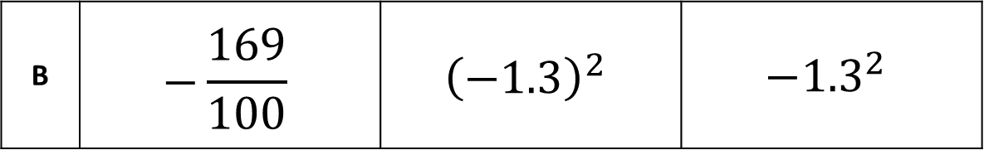
Going Deeper:
Why was this the odd one out? Why did this input give a different answer?
B | $$\text{−}\frac{\text{169}}{\text{100}}$$ | $${\left(\text{−1.3}\right)}^{2}$$ | $$−{1.3}^{2}$$

Slide 6
Going Deeper: ANSWER
Why was this the odd one out? Why did this input give a different answer?
B | $$\text{−}\frac{\text{169}}{\text{100}}$$ | $${\left(\text{−1.3}\right)}^{2}$$ | $$−{1.3}^{2}$$
All calculators follow the order of operations. By including brackets, we are telling the calculator that we want to square negative 1.3.

Slide 7
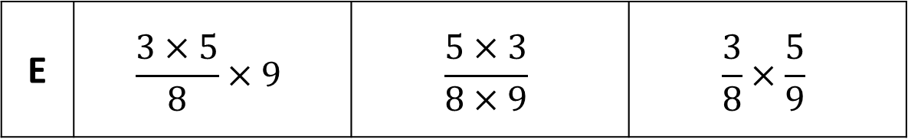
Going Deeper
Why was this the odd one out? Why did this input give a different answer?
Can you change one thing that would give the same answer as the final two calculations?
E | $$\frac{3×5}{8}×9$$ | $$\frac{5×3}{8×9}$$ | $$\frac{3}{8}×\frac{5}{9}$$

Slide 8
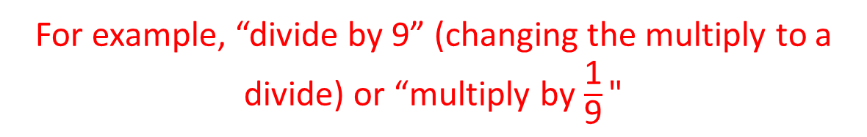
Going Deeper: ANSWER
Why was this the odd one out? Why did this input give a different answer?
Can you change one thing that would give the same answer as the final two calculations?
E | $$\frac{3×5}{8}×9$$ | $$\frac{5×3}{8×9}$$ | $$\frac{3}{8}×\frac{5}{9}$$
We are multiplying the fraction by 9, so the number gets 9 times bigger.
For example, “divide by 9” (changing the multiply to a divide) or “multiply by $\frac{\text{1}}{\text{9}}\text{"}$

Slide 9
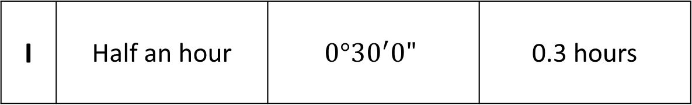
Going Deeper
Why was this the odd one out? Why did this input give a different answer?
How many minutes are in 0.5 hours?
I | Half an hour | $$0°{30}^{′}0"$$ | 0.3 hours

Slide 10
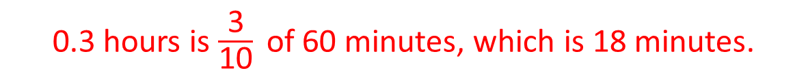
Going Deeper: ANSWER
Why was this the odd one out? Why did this input give a different answer?
How many minutes are in 0.5 hours?
I | Half an hour | $$0°{30}^{′}0"$$ | 0.3 hours
0.3 hours is $\frac{\text{3}}{\text{10}}$of 60 minutes, which is 18 minutes.
30 minutes

